Slide 1
Lubridate
CSCI 444

Slide 2

Works with date and time datatypes
Part of tidyverse
  Not automatically installed

Slide 3
Constructing a Date Data Type
Element | Function
August 1, 2024 | mdy()
2024-08-01 | ymd()
01-08-2024 | dmy()
August 1, 2024 04:32:16 | mdy_hms()
2024-08-01 04:32:16 | ymd_hms()
01-08-2024 04:32:16 | dmy_hms()
mdy("08-26-2024")
ydm("2024-26-08")
wday(mdy("08-26-2024")) → returns 2
  1- Sunday, 2 - Monday, 3 - Tuesday, etc.
yday(ydm("2024-26-08")) → returns 239

Slide 4
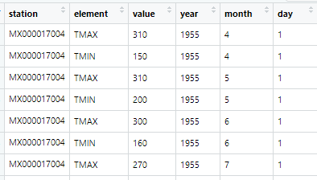
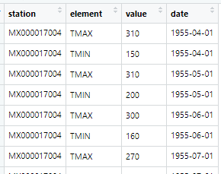
Mexican Weather STations
Mexicanweather <- read_csv("mexicanweather.csv", col_names = TRUE)
  date → date data type
Mexicanweather <- Mexicanweather %>%
mutate(year = year(date),
month = month(date),
day = day(date)) %>%
select(-date)

Slide 5
Paste v. Paste0
Use paste functions to concatenate strings
  paste → " " (space) is default delimiter
    Specify sep = if needed
  paste0 → "" (empty string) is delimiter
    Faster because no other delimiter is specified
num1 <- 987
num2 <- 65
num3 <- 4321
ssn <- paste(sep="-", as.character(num1),
as.character(num2),
as.character(num3))

Slide 6
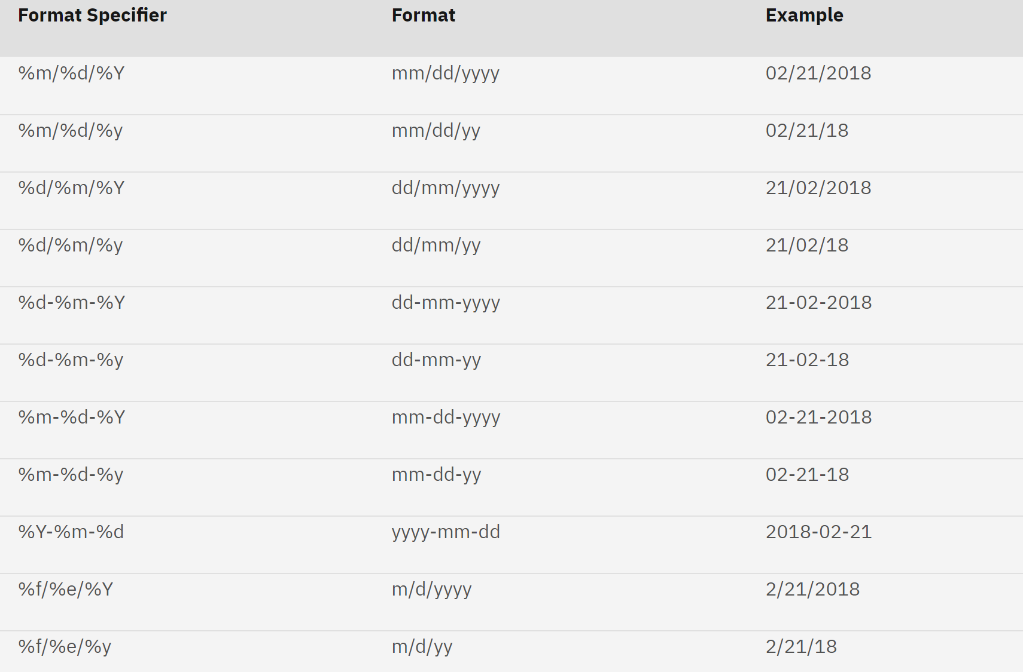
Date Format Specifiers
https://www.ibm.com/docs/en/cmofz/10.1.0?topic=SSQHWE_10.1.0/com.ibm.ondemand.mp.doc/arsa0257.htm

Slide 7
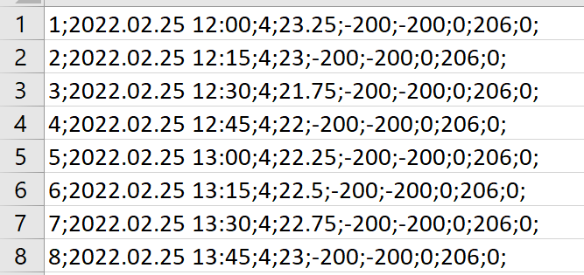
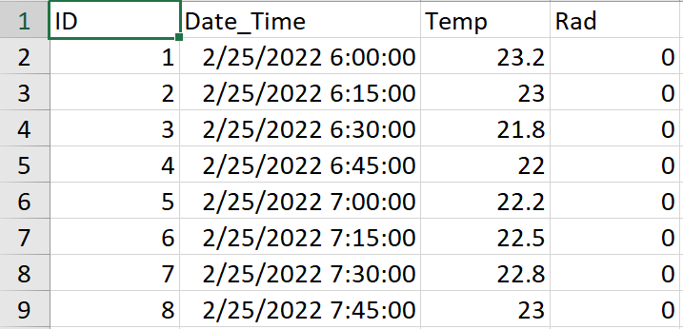
Example – Cyprus Tree DAta

Slide 8
Example
#Convert Date_Time to a different date format
oneFile <- oneFile %>%
mutate(Date_Time = format(with_tz(as_datetime(Date_Time, format="%Y.%m.%d %H:%M", tz = "GMT"), tz = "America/Chicago"), format = "%m/%d/%Y %H:%M")
#Convert Date_Time to POSIXct so it is recognized by Excel
oneFile <- oneFile %>%
mutate(Date_Time = with_tz(as.POSIXct(Date_Time, format = "%m/%d/%Y %H:%M", tz = "GMT"), tz = "America/Chicago"))
The Portable Operating System Interface (POSIX) is a family of standards
POSIXct stores date and time in seconds with the number of seconds beginning at 1 January 1970

